Slide 1
DATA and Types
INTRODUCTION

Slide 2
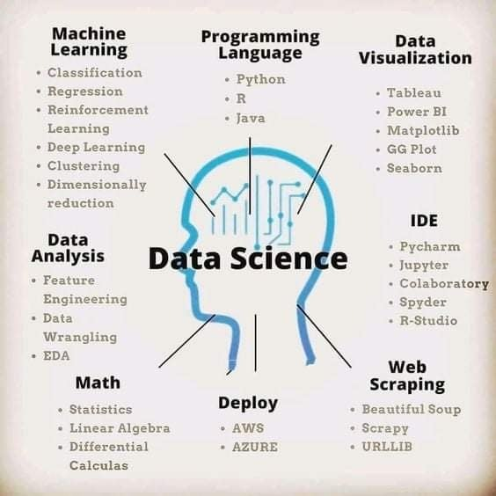

Slide 3
What is Data?
Data refers to facts and statistics collected together for reference or analysis

Slide 4
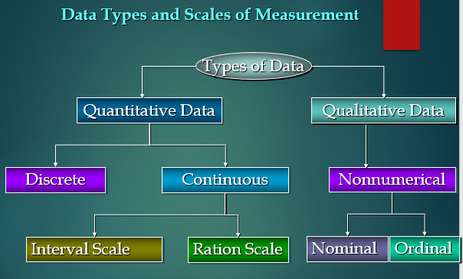
Data Types
Data Types are important in statistics to correctly apply statistical measurements.
Required to know to apply for exploratory data analysis (EDA)

Slide 5
Qualitative Data
Qualitative data is a bunch of information that cannot be measured in the form of numbers. It is also known as categorical data. It normally comprises words, narratives, and we labeled them with names.
It delivers information about the qualities of things in data. The outcome of qualitative data analysis can come in the type of featuring key words, extracting data, and ideas elaboration.
For examples:
Hair colour- black, brown, red
Opinion- agree, disagree, neutral

Slide 6
Quantitative Data
Quantitative data is a bunch of information gathered from a group of individuals and includes statistical data analysis. Numerical data is another name for quantitative data.
Simply, it gives information about quantities of items in the data and the items that can be estimated. And, we can formulate them in terms of numbers.
For examples:
We can measure the height (1.70 meters), distance (1.35 miles) with the help of a ruler or tape.
We can measure water (1.5 litres) with a jug.

Slide 7
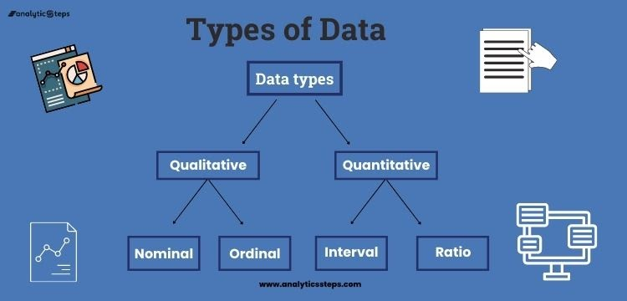
Quantitative Data
Under a subdivision, nominal data and ordinal data come under qualitative data. Interval data and ratio data come under quantitative data.

Slide 8
Nominal Data
It is used to label variables where there is no quantitative value and has no order.
Thus, nominal data are observed but not measured, are unordered but non-equidistant, and have no meaningful zero.
The only numerical activities you can perform on nominal data is to state that perception is (or isn't) equivalent to another (equity or inequity), and you can use this data to amass them.
You can't organize nominal data, so you can't sort them.
With nominal data, you can calculate frequencies, proportions, percentages, and central points.

Slide 9
Examples of Nominal Data
What languages do you speak?
English
German
French
Punjabi
What’s your nationality?
American
Indian
Japanese
German
You can clearly see that in these examples of nominal data the categories have no order.

Slide 10
Ordinal Data
Ordinal data is almost the same as nominal data but not in the case of order as their categories can be ordered like 1st, 2nd, etc.
Ordinal Data is observed but not measured, is ordered but non-equidistant, and has no meaningful zero. Ordinal scales are always used for measuring happiness, satisfaction, etc.
As ordinal data are ordered, they can be arranged by making basic comparisons between the categories, for example, greater or less than, higher or lower, and so on

Slide 11
Examples of Ordinal data
Opinion
Agree
Disagree
Mostly agree
Neutral
Mostly disagree
Time of day
Morning
Noon
Night
In these examples, there is an obvious order to the categories.

Slide 12
Interval Data
Interval Data are measured and ordered with the nearest items.
The central point of an Interval scale is that the word 'Interval' signifies 'space in between‘.
Interval data can be negative.
Interval data can easily correlate the degrees of the data and also you can add or subtract the values.
There are some descriptive statistics that you can calculate for interval data are central point (mean, median, mode), range (minimum, maximum), and spread (percentiles, interquartile range, and standard deviation).

Slide 13
Examples of Interval data
Temperature (°C or F, but not Kelvin)
Dates (1066, 1492, 1776, etc.)
Time interval on a 12-hour clock (6 am, 6 pm)

Slide 14
Ratio Data
Ratio Data are measured and ordered with equidistant items and a meaningful zero and never be negative like interval data.
An outstanding example of ratio data is the measurement of heights. It could be measured in centimeters, inches, meters, or feet and it is not practicable to have a negative height.
Ratio data is fundamentally the same as interval data, aside from zero means none.
The descriptive statistics which you can calculate for ratio data are the same as interval data which are central point (mean, median, mode), range (minimum, maximum), and spread (percentiles, interquartile range, and standard deviation).

Slide 15
Example of Ratio Data
Age (from 0 years to 100+)
Temperature (in Kelvin, but not °C or F)
Distance (measured with a ruler or any other assessing device)
Time interval (measured with a stop-watch or similar)
Therefore, for these examples of ratio data, there is an actual, meaningful zero-point like the age of a person, absolute zero, distance calculated from a specified point or time all have real zeros.

Slide 16
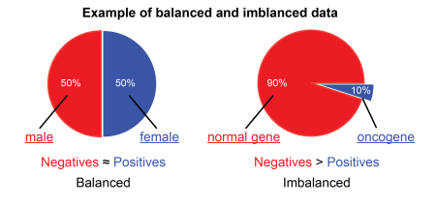
Balanced and Imbalanced Dataset

Slide 17

Balanced Dataset
Balanced Dataset: —If in our data set we have positive values which are approximately same as negative values. Then we can say our dataset in balance.

Slide 18
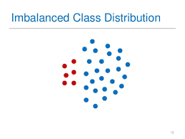
ImBalanced Dataset
ImBalanced Dataset: — If there is the very high different between the positive values and negative values. Then we can say our dataset in Imbalance Dataset.

Slide 19
Structured and Unstructured Data
Structured data is data that has been predefined and formatted to a set structure before being placed in data storage, which is often referred to as schema-on-write.
Example of structured data is the relational database.
Unstructured data is data stored in its native format and not processed until it is used, which is known as schema-on-read. It comes in a myriad of file formats, including email, social media posts, presentations, chats, IoT sensor data, and satellite imagery.

Slide 20
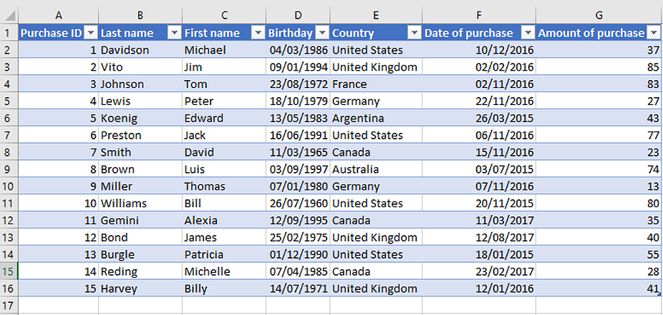
Example of Structured Data

Slide 21

Example of Unstructured Data

Slide 22
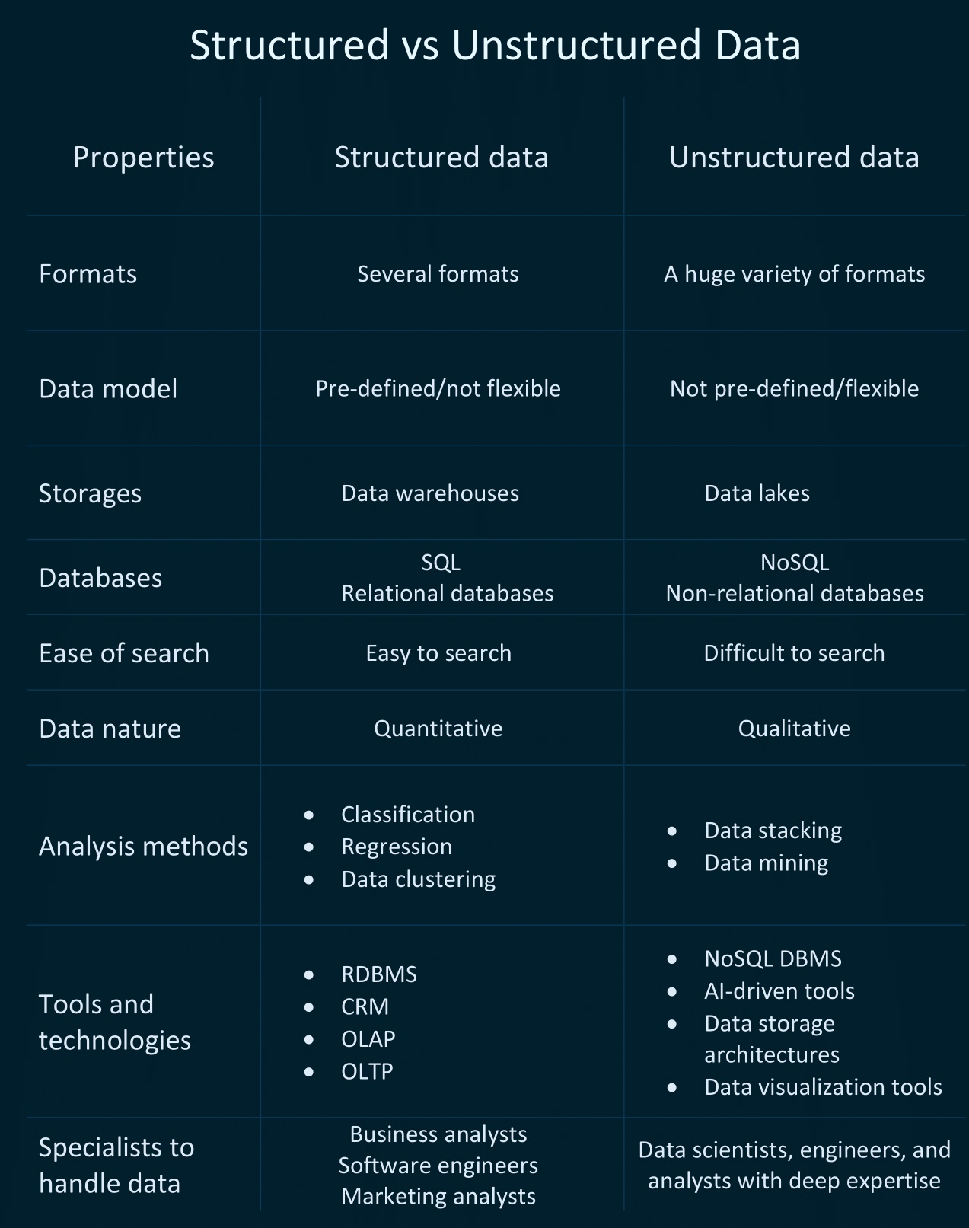

Slide 23
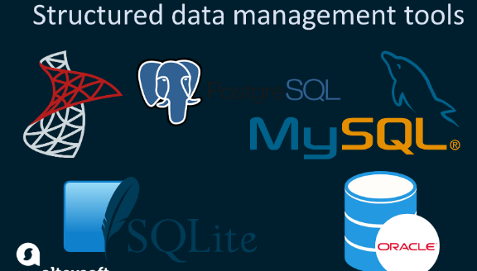


Slide 24
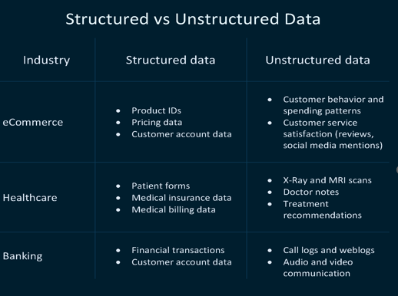
Industrial example of Structured and Unstructured Data

Slide 25
Semi-Structured data
Semi-structured data refers to what would normally be considered unstructured data, but that also has metadata that identifies certain characteristics.
The metadata contains enough information to enable the data to be more efficiently cataloged, searched, and analyzed than strictly unstructured data.
Example :tab delimited file containing customer data

Slide 26
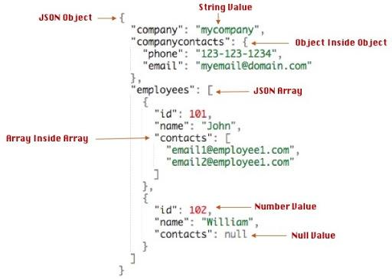
Example
Markup languages such as XML are the forms of semi-structured data. JSON is also a semi-structured data model that is used by new-generation databases such as MongoDB and Couchbase.

Slide 27


